Slide 1

The Fourth Hour!
Welcome to…
Notes:
PI about here is a piece of code what are the best set of test cases (have some be redundant)

Slide 2
Introduction
Welcome to the Fourth Hour!
Name
Professor
A fun fact about you

Slide 3
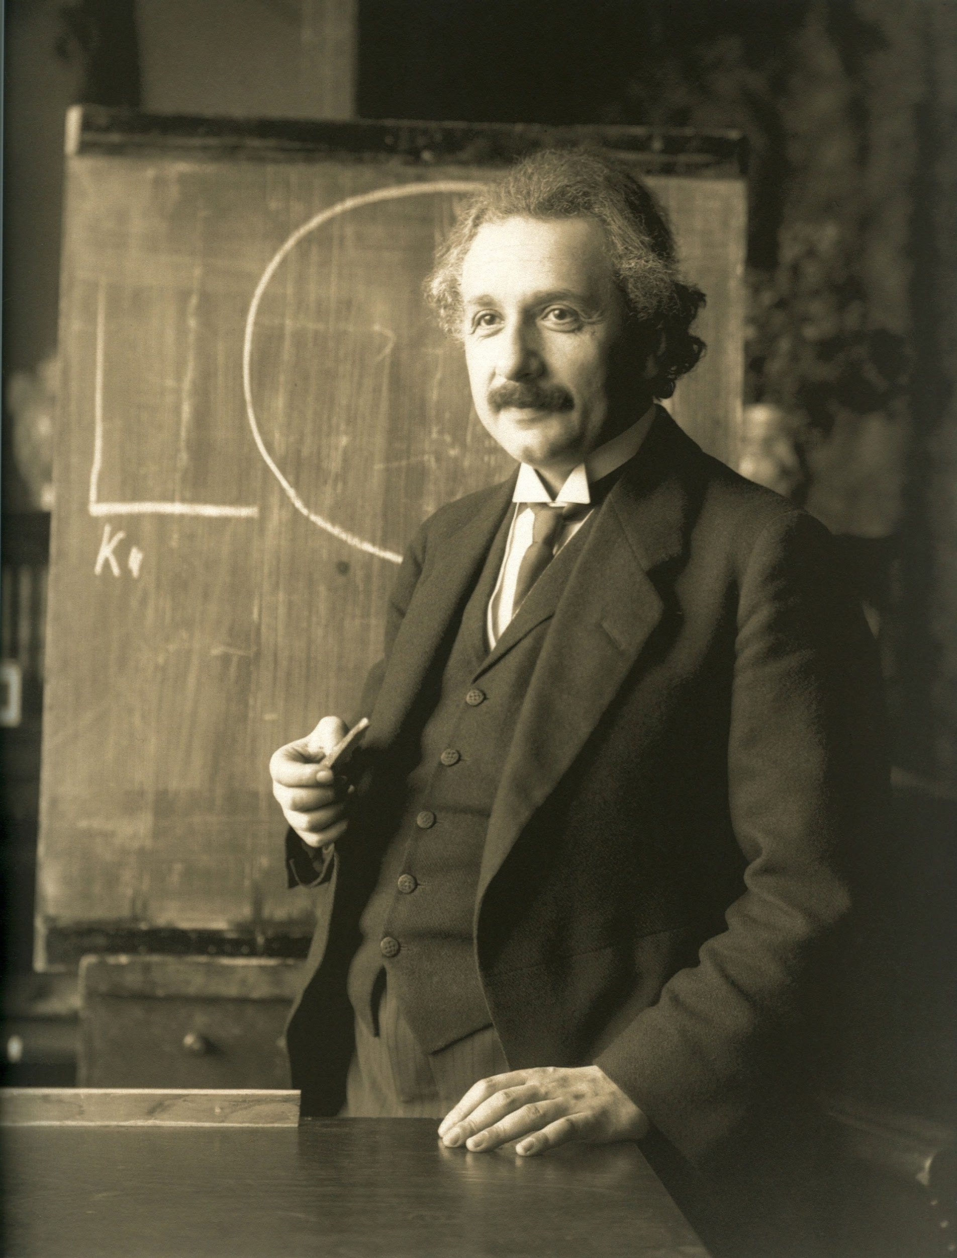
“Anyone who has never made a mistake has never tried anything new.”

Slide 4
Testing code
Coding can sometimes be tricky and it can be hard to find bugs in code
Writing/Brainstorming possible test cases before coding can actually help finding an accurate solution quickly
Why?

Slide 5
Testing code
Coding can sometimes be tricky and it can be hard to find bugs in code
Writing/Brainstorming possible test cases before coding can actually help finding an accurate solution quickly
Why?
We get a better understanding of what we want our functions to do or return given certain input

Slide 6
How do we know what test cases we need
First read the assignment specifications (specs)
This way we know the intended behavior

Slide 7
How do we know what test cases we need
First read the assignment specifications (specs)
This way we know the intended behavior
Look for boundaries and test at boundary points
Ex. The user is only allowed to input a number between and inclusive 0-100.

Slide 8
How do we know what test cases we need
First read the assignment specifications (specs)
This way we know the intended behavior
Look for boundaries and test at boundary points
Ex. The user is only allowed to input a number between and inclusive 0-100.
Write a test for outside lower boundary ( ex. -1)
Write a test for outside upper boundary (ex. 101)
Write a test for low boundary - 0
Write a test for high boundary - 100
Write a test for normal operation - 35

Slide 9
How do we know what test cases we need
First read the assignment specifications (specs)
This way we know the intended behavior
Look for boundaries and test at boundary points
Ex. The user is only allowed to input a number between and inclusive 0-100.
Write a test for outside lower boundary ( ex. -1)
Write a test for outside upper boundary (ex. 101)
Write a test for low boundary - 0
Write a test for high boundary - 100
Write a test for normal operation - 35
Look for inputs that result in different behavior
Ex. If the input is negative print out “Alert!”

Slide 10
How do we know what test cases we need
First read the assignment specifications (specs)
This way we know the intended behavior
Look for boundaries and test at boundary points
Ex. The user is only allowed to input a number between and inclusive 0-100.
Write a test for outside lower boundary ( ex. -1)
Write a test for outside upper boundary (ex. 101)
Write a test for low boundary - 0
Write a test for high boundary - 100
Write a test for normal operation - 35
Look for inputs that result in different behavior
Ex. If the input is negative print out “Alert!”
Write a test for any negative number
Also write a test for any positive number (make sure “Alert” is not printed)

Slide 11
Review
Login to Socrative at https://b.socrative.com/login/student/
Use code 4thHour149

Slide 12
Question 1
Given a function called foo that takes in a parameter named x. When x is divisible by 3 return the string “foo”. When x is divisible by 5 return “bob”. When x is divisible by both 5 and 3 return the string “foobob”. If none of the conditions pass return an empty string.
What is the best set of test cases from the choices below for this problem?
In other words, what numbers should we test with this method?
1, 2, 3, 4, 5, 6, 7, 8, 9, 10, … 100
2, 4, 6, 8, 10, 12
3, 5, 10, 2
3, 5, 15, 4
9, 10, 3, 5
5, 3, 15
Notes:
C) is incorrect b/c we do not have a condition in which a number is divisible by both 5 and 3.
Differing behavior cases are being checked in this case. Each case above will result in a different return value.

Slide 13
Question 1
Given a function called foo that takes in a parameter named x. When x is divisible by 3 return the string “foo”. When x is divisible by 5 return “bob”. When x is divisible by both 5 and 3 return the string “foobob”. If none of the conditions pass return an empty string.
What is the best set of test cases from the choices below for this problem?
In other words, what numbers should we test with this method?
1, 2, 3, 4, 5, 6, 7, 8, 9, 10, … 100
2, 4, 6, 8, 10, 12
3, 5, 10, 2
3, 5, 15, 4
9, 10, 3, 5
5, 3, 15
Notes:
C) is incorrect b/c we do not have a condition in which a number is divisible by both 5 and 3.
Differing behavior cases are being checked in this case. Each case above will result in a different return value.

Slide 14
How do we write test cases?
We can write test cases several ways:
The first way is to print the results of function calls in our program, either in a main function or any place in the program.

Slide 15
How do we write test cases?
We can write test cases several ways:
The first way is to print the results of function calls in our program, either in a main function or any place in the program.
For example:
print(“foo test with value 3 was:”, foo(3))
print(“Expected the value to be: foo”)

Slide 16
Now you try!
Write 3 more test cases for this problem using the answer from the previous socrative question:
Write a function called foo that takes in a parameter named x. When x is divisible by 3 print foo. When x is divisible by 5 print bob. When x is divisible by both 5 and 3 print foobob. If none of the conditions pass only the number should be printed out.
3, 5, 15, 4

Slide 17
How’d you do?
print(“foo test with value 5:”, foo(5)) print (“Expected the value to be: bob”)
print(“foo test with value 15:”, foo(15)) print(“Expected the value to be: foobob”)
print(“foo test with value 4:”, foo(4)) print(“Expected the value to be: ”)

Slide 18
Testing with AssertEquals
Let’s write some tests with AssertEquals for this method, here is an example.
def test_foo(self):
self.assertEqual(“foo”, foo(3))

Slide 19
Testing with AssertEquals
Let’s write some tests with AssertEquals for this method, here is an example.
def test_foo(self):
self.assertEqual(“foo”, foo(3))
self.assertEqual(“foobob”, foo(15))
self.assertEqual(“bob”, foo(5))
self.assertEqual(“”, foo(4))

Slide 20
Testing using input()
It can be tedious testing with the input function
Everytime I want to test I have to type in every single value
If a problem happens I have to enter everything again
If I want to test multiple test cases I have to type all of them in one after the other
You also have to keep in mind that input() returns a string. You need to typecast the input to a different type if needed.
TLDR → don’t test with input() just hard code inputs or make test cases
Notes:
explain how to hard code inputs
# a = input()
a = “test”

Slide 21
Testing using input()
So if we have the code:
a = input()
print(a[-1])

Slide 22
Testing using input()
So if we have the code:
# a = input()
a = “testing”
print(a[-1])

Slide 23
Question 2 - PI
Given a function called ID that takes in a parameter named name. When name has an odd length it prints the middle initial. When name has an even length it prints the middle 2 initials. If the name is less than 1 length the program should ask the user to reenter.
What is the best set of test cases from the choices below for this problem?
In other words, what numbers should we test with this method?
“Tim”, “Tom”, “Jerry”,””
“Tim”, “Jack”, “”
“Tim”, “”
“Tim”, “Tom”, “Jerry”,”Carter”,”Alyssa”,”Cory”, “”

Slide 24
Question 2 - PI
Given a function called ID that takes in a parameter named name. When name has an odd length it prints the middle initial. When name has an even length it prints the middle 2 initials. If the name is less than 1 length the program should ask the user to reenter.
What is the best set of test cases from the choices below for this problem?
In other words, what numbers should we test with this method?
“Tim”, “Tom”, “Jerry”,””
“Tim”, “Jack”, “”
“Tim”, “”
“Tim”, “Tom”, “Jerry”,”Carter”,”Alyssa”,”Cory”, “”

Slide 25
What do I do if my code doesn’t pass my tests?
Debug!
It’s okay if you’re not super comfortable with it yet. It can be daunting, so we’ll go through an example together!

Slide 26
Debugging using print statements
Below is some code with errors:
def calc_total (original_price, discount, tax_rate): new_total = inital_cost - discount new_total = new_total + (new_total * (tax_rate // 100)) return new_total
Let’s settle on test values, then use print statements to see what’s going on.
Notes:
Online python compiler link with code: https://onlinegdb.com/BhOxzGGuR

Slide 27
Debugging using print statements
Below is some code with errors:
def calc_total (original_price, discount, tax_rate): new_total = inital_cost - discount print(“after discount”, new_total) new_total = new_total + (new_total * (tax_rate // 100)) return new_total
Notes:
Online python compiler link with code: https://onlinegdb.com/BhOxzGGuR
Check what the value of new_total is after the first line. With values (15, 5, 10), it should be 10.

Slide 28
Debugging using print statements
Below is some code with errors:
def calc_total (original_price, discount, tax_rate): new_total = inital_cost - discount print(“after discount”, new_total) new_total = new_total + (new_total * (tax_rate // 100)) return new_total
Notes:
Online python compiler link with code: https://onlinegdb.com/BhOxzGGuR
Printed line matches what we expected. Our next statement must be the problem

Slide 29
Debugging using print statements
Below is some code with errors:
def calc_total (original_price, discount, tax_rate): new_total = inital_cost - discount print(“after discount”, new_total) new_total = new_total + (new_total * (tax_rate // 100)) print(“after tax”, new_total) return new_total
Notes:
Online python compiler link with code: https://onlinegdb.com/BhOxzGGuR
Check what the new_total is after our second statement. With test values (15, 5, 10) it should be 11

Slide 30
Debugging using print statements
Below is some code with errors:
def calc_total (original_price, discount, tax_rate): new_total = inital_cost - discount print(“after discount”, new_total) new_total = new_total + (new_total * (tax_rate // 100)) print(“after tax”, new_total) return new_total
Notes:
Online python compiler link with code: https://onlinegdb.com/BhOxzGGuR
That gave us the wrong answer, check the calculation we’re doing

Slide 31
Debugging using print statements
Below is some code with errors:
def calc_total (original_price, discount, tax_rate): new_total = inital_cost - discount print(“after discount”, new_total) new_total = new_total + (new_total * (tax_rate // 100)) print(“tax amount”, new_total * (tax_rate // 100))) print(“after tax”, new_total) return new_total
Notes:
Online python compiler link with code: https://onlinegdb.com/BhOxzGGuR
Should give us $1 with values (15, 5, 10)

Slide 32
Debugging using print statements
Below is some code with errors:
def calc_total (original_price, discount, tax_rate): new_total = inital_cost - discount print(“after discount”, new_total) new_total = new_total + (new_total * (tax_rate // 100)) print(“tax amount”, new_total * (tax_rate // 100))) print(“after tax”, new_total) return new_total
Notes:
Online python compiler link with code: https://onlinegdb.com/BhOxzGGuR
Should give us $1 with values (15, 5, 10)

Slide 33
Debugging using print statements
Changing from integer division to regular division fixes our problem!
def calc_total (original_price, discount, tax_rate): new_total = inital_cost - discount print(“after discount”, new_total) new_total = new_total + (new_total * (tax_rate / 100)) print(“tax amount”, new_total * (tax_rate / 100))) print(“after tax”, new_total) return new_total
Notes:
Online python compiler link with code: https://onlinegdb.com/BhOxzGGuR
Updated code returns $11
Even though python defaults to float division, getting the idea of types and the difference between different operations is important

